Slide 1
Object Oriented Design Issues

Slide 2
FP vs OOP
In FP (and procedural), programs break down into functions that perform some operations
Functions may take one or more arguments
In OOP, programs break down into classes that give behavior to some kind of data
These two approaches are exactly opposite and provide complementary perspectives to the same problem
Which approach to take depends on how the software is planned to be extended

Slide 3
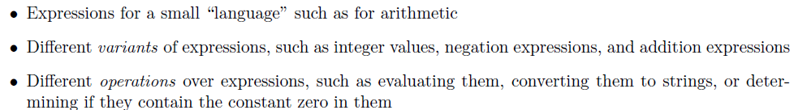
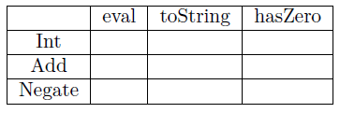
Example of a Common Programming Pattern

Slide 4
Common Programming Pattern
Conceptual matrix must be solved to decide the entry of each grid of the matrix

Slide 5
Functional Approach
Define a datatype for expressions, with one constructor for each variant
Define a function for each operation
In each function, have a branch (e.g., via pattern-matching) for each variant of data
If there is a default for many variants, we can use something like a wildcard pattern to avoid enumerating all the branches

Slide 6
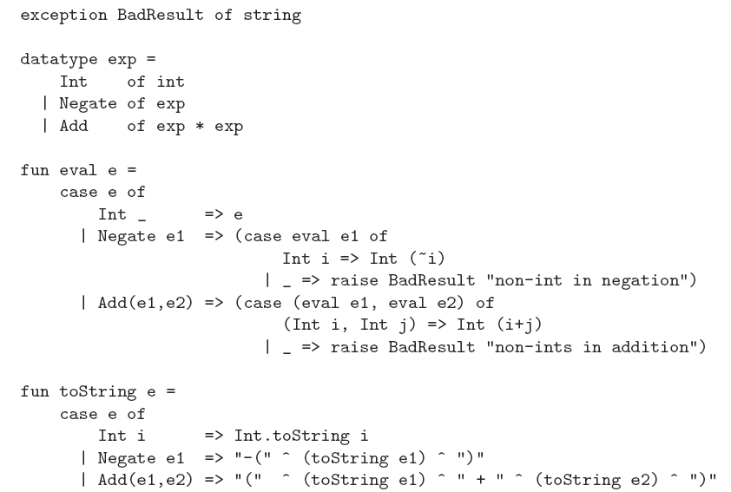
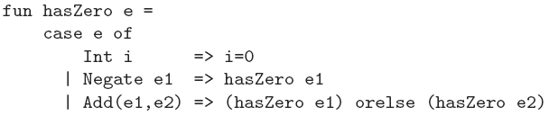

Slide 7
Object Oriented Approach
Define a class for expressions, with one abstract method for each operation
Define a subclass for each variant of data
In each subclass, have a method definition for each operation
If there is a default for many variants we can use a method definition in the superclass so that via inheritance we can avoid enumerating all the branches
This approach is data-oriented decomposition: breaking the problem down into classes corresponding to each data variant

Slide 8
Comparison
Functional decomposition breaks programs down into functions that perform some operation and object-oriented decomposition breaks programs down into classes that give behavior to some kind of data
Its about deciding whether to lay out a program “by column” or “by row”
This is needed in conceptualizing software or deciding how to decompose a problem
Various tools and IDEs help to view a program in a way different than how the code is decomposed

Slide 9
Comparison: Context of the Example
It is “more natural” to have the cases for eval together rather than the operations for Negate together
For problems like implementing graphical user interfaces, the object-oriented approach is probably more popular
It is “more natural” to have the operations for a kind of data (like a MenuBar) together (such as backgroundColor, height, and doIfMouseIsClicked rather than have the cases for doIfMouseIsClicked together (for MenuBar, TextBox, SliderBar, etc.)

Slide 10
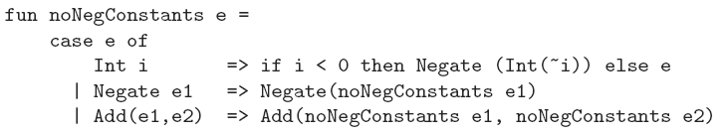
Extensibility
Adding a new operation is easy following functional approach
Adding a new data variant, such as Mult of exp * exp is less pleasant
In OOP approach it is just the opposite

Slide 11
Plan for Unplanned Extensions
Making software that is both robust and extensible is valuable but difficult
Extensibility can make the original code more work to develop, harder to reason about locally, and harder to change(without breaking extensions)
In fact, languages often provide constructs exactly to prevent extensibility
Final class cannot be extended

Slide 12
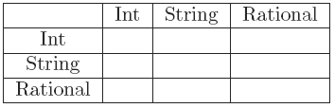
More Extensions to the Problem
The methods may take two or more arguments or evaluating the expressions can be more complicated if different kinds of data are considered
Add can be modified as follows
If the arguments are ints or rationals, do the appropriate arithmetic
If either argument is a string, convert the other argument to a string (unless it already is one) and return the concatenation of the strings.

Slide 13
More Extensions to the Problem
If many cases work the same way, we can use wildcard patterns and/or helper functions to avoid redundancy
One common source of redundancy is commutativity, i.e., the order of values not mattering
adding a rational and an int is the same as adding an int and a rational
Value eval() {
return new Int(((Int)(e1.eval())).i + ((Int)(e2.eval())).i);
}

Slide 14
Binary methods in OOP
Value eval() {
return e1.eval().add_values (e2.eval());
}
An Int, MyRational, or MyString should “know how to add itself to another value”
By putting add_values methods in the Int, MyString, and MyRational classes, the work is divided into three pieces using dynamic dispatch depending on the class of the object that e1.eval returns, i.e., the receiver of the add_values call in the eval method in Add

Slide 15
Binary methods in OOP
But then each of these three needs to handle three of the nine cases, based on the class of the second argument
Any of addInt(..), addMyString(..), addMyRational(…) of Int class would be called if the first argument is Int
While this approach works, it is really not object-oriented programming. Rather, it is a mix of object-oriented decomposition (dynamic dispatch on the first argument) and functional decomposition (using is_a? to figure out the cases in each method)
The extensibility advantage of OOP is lost!

Slide 16
Multimethods
OOP languages with multimethods, do not require the manual double dispatch
Each add_values method would indicate the class it expects for its argument
Then e1.eval.add_values e2.eval would pick the right one of the 9 by, at run-time, considering the class of the result of e1.eval and the class of the result of e2.eval

Slide 17
Multimethods
In languages that support multimethods, one can have multiple methods in a class with the same name and the method-call semantics does use the types of the arguments to choose what method to call
But it uses the types of the arguments, which are determined at compile-time and not the run-time class of the result of evaluating the arguments. This semantics is called static overloading
Static overloading is considered useful and convenient, but it is not multimethods and does not avoid needing double dispatch

Slide 18
Interfaces-Multiple Inheritance
Implementing interfaces does not inherit code
It is purely related to type-checking in statically typed languages like Java and C#
It makes the type systems in these languages more flexible
So Ruby- dynamically typed language, does not need interfaces
If two interfaces have a method-name conflict, it does not matter — a class can still implement them both
If two interfaces disagree on a method’s type, then no class can possibly implement them both but the type-checker will catch that

Slide 19
Abstract Class
We can have expressions with the type of the superclass and know that at run-time the object will actually be one of the subclasses
Furthermore, type-checking ensures the object’s class has implemented all the abstract methods, so it is safe to call these methods
In C++, abstract methods are called “pure virtual methods” and serve much the same purpose

Slide 20
Abstract Methods vs Higher Order Functions
The language supports a programming pattern where some code is passed other code in a flexible and reusable way
In OOP, different subclasses can implement an abstract method in different ways and code in the superclass, via dynamic dispatch, can then uses these different implementations
With higher-order functions, if a function takes another function as an argument, different callers can provide different implementations that are then used in the function body

Slide 21
Subtyping
Static types for object-oriented programs, such as those found in Java is important
If everything is an object (which is less true in Java than in Ruby), then the main thing we would want our type system to prevent is “method missing” errors, i.e., sending a message to an object that has no method for that message
If objects have fields accessible from outside the object (e.g., in Java), then we also want to prevent “method missing" errors
There are other possible errors as well, like calling a method with the wrong number of arguments
While languages like Java and C# have generics these days, the source of type-system expressiveness most fundamental to object-oriented style is subtype polymorphism, also known as subtyping
A key source of expressiveness in ML‘s type system is parametric polymorphism, also known as generics

Slide 22
Subtyping-small example
In the expression {f1=e1, f2=e2, ..., fn=en}, each fi is a field name and each ei is an expression.
The semantics is to evaluate each ei to a value vi and the result is the record value {f1=v1, f2=v2, ..., fn=vn}
So a record value is just a collection of fields, where each field has a name and a content
For the expression e.f, we evaluate e to a value v.
If v is a record with an f field, then the result is the contents of the f field
Our type system will ensure v has an f field
For the expression e1.f = e2, we evaluate e1 and e2 to values v1 and v2
If v1 is a record with an f field, then we update the f field to have v2 for its contents.
Our type system will ensure v1 has an f field
Like in Java, we will choose to have the result of e1.f = e2 be v2, though usually we do not use the result of a field-update

Slide 23
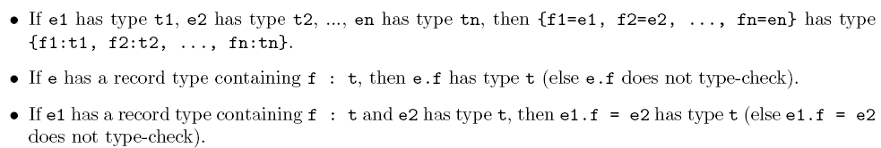
Type System
{x : real, y : real} would describe records with two fields named x and y that hold contents of type real

Slide 24
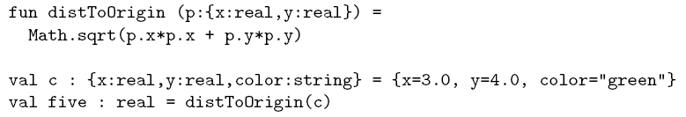
Problem of Type System
With these typing rules the program would not type-check
In the call distToOrigin(c), the type of the argument is {x:real,y:real,color:string} and the type the function expects is {x:real,y:real}, breaking the typing rule that functions must be called with the type of argument they expect
Yet the program above is safe: running it would not lead to accessing a field that does not exist.

Slide 25
Subtyping
Requires addition of
If some expression has a record type {f1:t1, ..., fn:tn}, then let the expression also have a type where some of the fields are removed
Letting an expression that has one type also have another type that has less information is the idea of subtyping
A subtype has more information
There are “fewer" values of the subtype than of the supertype because values of the subtype have more obligations, e.g., having more fields

Slide 26
Subtyping rule
The subtyping rule added to the type system is
Now t1<: t2 needs to be defined
We have separated the idea of subtyping into a single binary relation that we can define separately from the rest of the type system

Slide 27
Defining Subtype
One guiding principle for defining subtyping rule is substitutability
If we allow t1 <: t2, then any value of type t1 must be able to be used in every way a t2 can be
For records, that means t1 should have all the fields that t2 has and with the same types

Slide 28
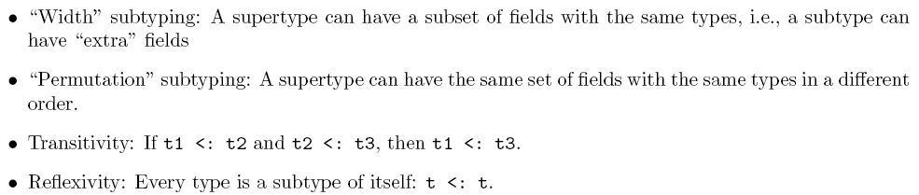
Subtyping Rules
These 2 rules are common in any language with subtyping because they combine well with other rules
Width subtyping lets us forget fields
Permutation subtyping lets us reorder fields
we can pass a {x:real,y:real} in place of a {y:real,x:real}) and transitivity with those rules lets us do both
we can pass a {x:real,foo:string,y:real} in place of a {y:real,x:real})

Slide 29
Depth Subtyping
Subtyping rules do not allow
To allow depth subtyping :

Slide 30
Depth Subtyping
In a language with records (or objects) with getters and setters for fields, depth subtyping is unsound; you cannot have a different type for a field in the subtype and the supertype
However, if a field is not settable (i.e., it is immutable), then the depth subtyping rule is sound
So this is yet another example of how not having mutation makes programming easier. In this case, it allows more subtyping, which lets us reuse code more.
Another way to look at the issue is that given the three features of
(1) setting a field,
(2) letting depth subtyping change the type of a field, and
(3) having a type system actually prevent field-missing errors,
we can have any two of the three.

Slide 31
Java Perspective
Subtyping, even depth subtyping is implemented in java with mutable fields at the cost of runtime checks
Adds flexibility to the language as the same sort methods could sort both Point and ColorPoint objects
A better solution is generics

Slide 32
Function Subtyping
it is safe to pass in a function with a return type that promises more, i.e., returns a subtype of the needed return type for the function
Returns ColorPoint instead of Point
In general, the rule here is
if ta <: tb, then t -> ta <: t -> tb, i.e., the subtype can have a return type that is a subtype of the supertype's return type
Return types are covariant for function subtyping meaning the subtyping for the return types works \the same way" (co) as for the types overall.

Slide 33
Function Subtyping
Argument types are not covariant for function subtyping
For arguments
ta <: tb, does not mean ta -> t <: tb -> t
The treatment of argument types for function subtyping is “backwards“
If tb <: ta, then ta -> t <: tb -> t
Contravariance, meaning the subtyping for argument types is the reverse (contra) of the subtyping for the types overall
The general rule is
If t3 <: t1 and t2 <: t4, then t1->t2 <: t3->t4
{x:real} -> {x:real,y:real,color:string} is a subtype of
{x:real,y:real} -> {x:real,y:real}
Function subtyping is needed for higher-order functions or for storing functions themselves in records

Slide 34
Function Subtyping in Java/C#
In Java/C#, subtyping rules soundly prevents \eld missing" and \method missing" errors
A subclass can add elds but not remove them
A subclass can add methods but not remove them
A subclass can override a method with a covariant return type
A class can implement more methods than an interface requires or implement a required method with a covariant return type
A class defines an object's behavior
Subclassing inherits behavior, modifying behavior via extension and override
A type describes what fields an object has and what messages it can respond to
Subtyping is a question of substitutability and checking for a type error
In Java/C#, every class declaration introduces a class an a type with the same name

Slide 35
Generics vs Subtyping
Generics are good for functions that operate over collections/containers where different collections/containers can hold values of different types:
length of a list or swapping two elements of a list
Subtyping works well in graphical user interfaces
Much of the code for graphics libraries works fine for any sort of graphical element (“paint it on the screen," “change the background color," “report if the mouse is clicked on it," etc.) where different elements such as buttons, slider bars, or text boxes can then be subtypes
In a language with generics (and no subtyping), higher order functions can be used for code reuse but it may become cumbersome

Slide 36
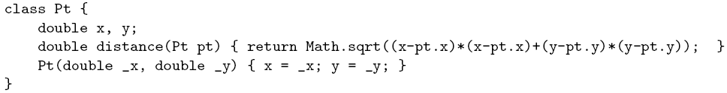
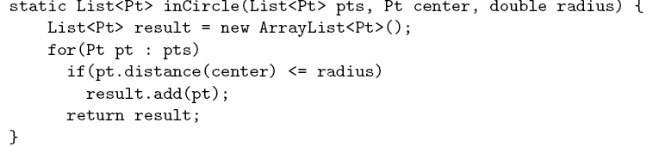
Bounded Polymorphism
The key idea is to have bounded generic types, where instead of just saying “a subtype of T" or “for all types 'a," we can say, “for all types 'a that are a subtype of T“

Slide 37
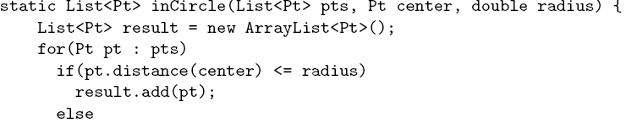

Nongeneric Method

Slide 38
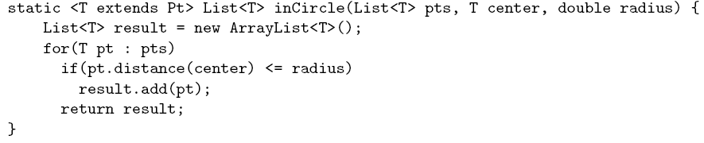
Bounded polymorphism
if center has type Pt, then the call result.add(center) does not type-check since Pt may not be a subtype of T

Slide 39
Thank you

